Slide 1
AirBnB Investment

Slide 2
Cleaning documentation
House
House
1) Looked for duplicates in all ID columns and URLs.
2) Looked for Blanks or special characters in each column
3) Deleted unrelated columns, including: url's, photos, notes, descriptions, duplicates.
Rent
Rent
Penthouse
Penthouse
Sale
Sale

Slide 3
Problems
Should our investor invest in an Airbnb hotel in Washington, D.C.?
If so, in which neighborhood should they invest?
How much revenue do successful hosts make?

Slide 4
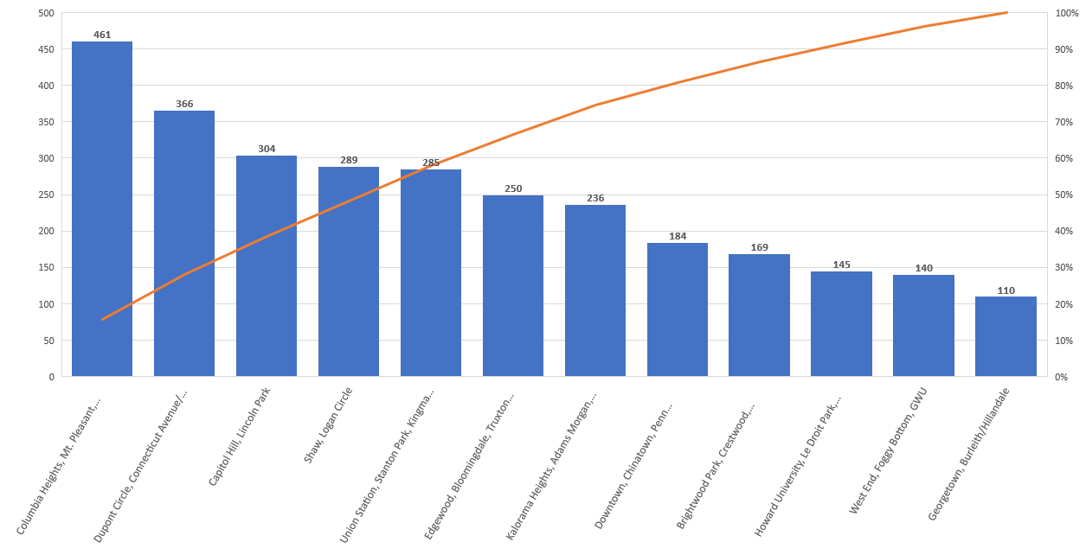
Most booked Neighborhood

Slide 5
Host name/Revenue

Slide 6
Property type/Revenue

Slide 7
Recommendation
461
Columbia Heights, Mt. Pleasant, Pleasant Plains, Park View
$920,192
Comfortable private room w/balcony
As Columbia Heights is the most booked neighborhood, it scores 461 we do recommend investing in it. Thus investing in an Airbnb hotel in Washington, D.C. is a good idea.
Successful hosts generate very high revenues, the highest 10 most generated ranged from ($920,192 the most highest revenue) till ($ 154,290 the 10th lower among the highest)

Slide 8
Thank you Nada Alsulaiman Nora Alabdulqader

